Slide 1
How to comply with 2013/55/EU
-
consequences of non-compliance
Updating Annexe V
David Hubert david@hubertconsulting.com
@hubertconsult
David Hubert david@eumonitr.com
@hubertconsult

Slide 2
Why it is important
What we can expect
What already exists
Group sessions
What’s next

Slide 3
Why it is important

Slide 4
Mismatch
Annexe V dates back to 1977
Article 31 (7) came into force in January
Present mismatch between art. 31 and Annexe V
Legal uncertainty for regulators
Opportunity to raise quality of training

Slide 5
What can we reasonably expect?

Slide 6
Scope of changes
Each proposed changes shall be justified in light of "scientific and technical progress", and
Shall NOT affect the “existing essential legislative principles in Member States regarding the structure of professions as regards training and conditions of access by natural persons” and
Shall “respect the responsibility of the Member States for the organisation of education systems”.

Slide 7
Scope of changes
Changes may include modifying the existing subjects, adding new ones or regrouping them to ensure that the minimum required training programme is up to date.

Slide 8
What already exists?

Slide 9
Current Annexe V
Theoretical instruction
Nursing
Basic sciences
Social sciences
Clinical instruction

Slide 10
National frameworks

Slide 11
EFN Framework
EFN Working Group on Competences (Chaired by Prof. Gonzales Jurado)
Framework aimed as guideline to implement competences expressed in article 31(7) into national nursing curricula
Establishes logic pathway btw competences and list of topics for nurse education

Slide 12
EFN Framework
CA.1. Culture Ethics and values
CA.2. Health promotion and prevention, guidance and teaching
CA.3. Decision-making
CA.4. Communication and teamwork
CA.5. Research and leadership
CA.6. Nursing care (theory)
CA.6. Nursing care (practice)

Slide 13
Working sessions
What already exist?

Slide 14
Programme
2 Groups – Anne Trotter / Mary Gobbi
Discussions on 5 thematic clusters
Reference Art 31, EFN Framework
Agree on list of content
reflect modern practice
Future-proof

Slide 15
Output
Competent authorities’ input into update of Annexe V

Slide 16
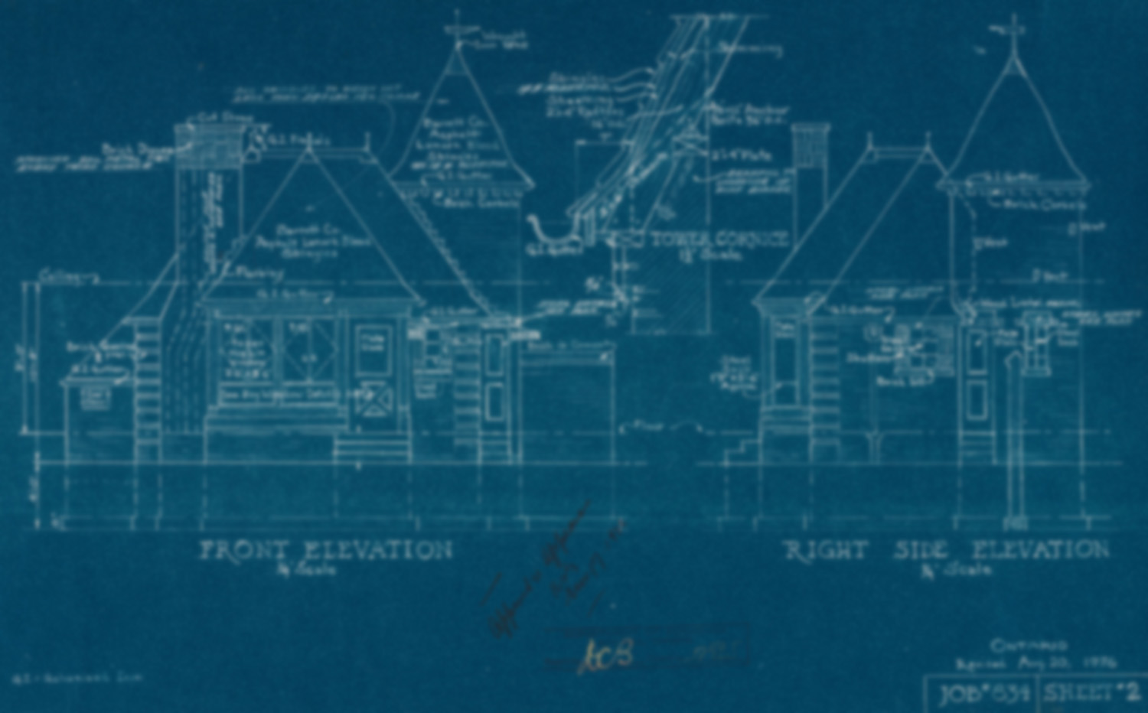
Next steps

Slide 17
Consolidate list of content
Consult all Nursing competent authorities
Cooperation with EFN
Common approach in response to Commission consultation in 2017

Slide 18
David Hubert
david@eumonitr.com
@hubertconsult
www.eumonitr.com

